Slide 1
סיכום תוצאות ומסקנות
יולי תשובה, סמל
21/05/26

Slide 2
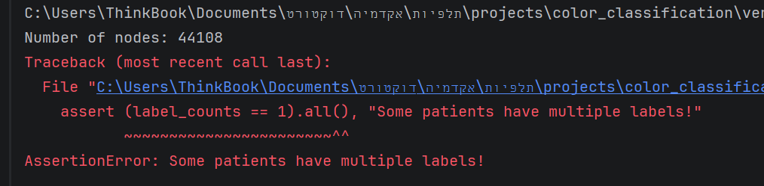
בעיה בקוד ליצור הגרף

Slide 3
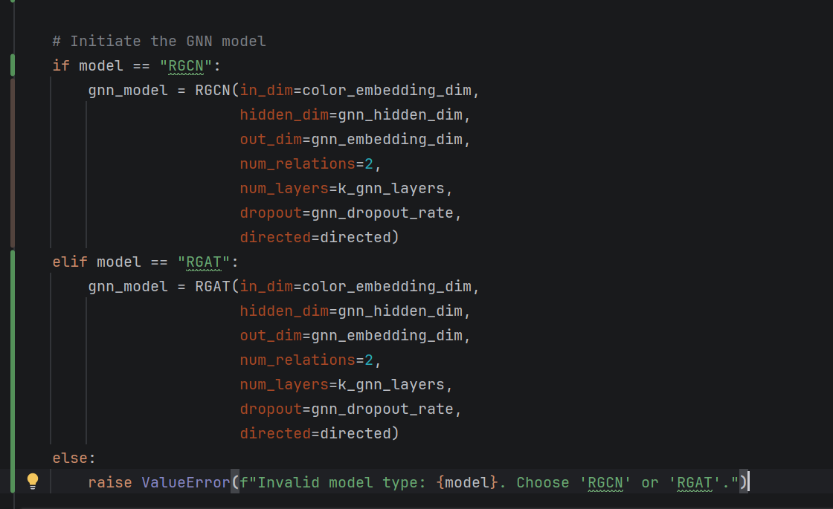
SOTA GNN generalization
Relational Graph Attention (RGAT)
HGT (Heterogeneous Graph Transformer) – Can be used if we design a new node for each color and connect it with all its nodes. Then there is no significant meaning to the edge relation.

Slide 4
What are we interested of?
We have a pipeline that can run each graph separately and measure results.
Just to make sure: Do we want to find the HP combination that maximize the mean results over all datasets? This can be run during the following this few days and be extracted.

